Slide 1
PBL Power HOur(s)
Niki Childers, Jag-Kansas
Amy Moore, iowa-JAG
Karey Webb JAG-Missouri

Slide 2
Welcome to PBL Power HOur(s)!
1. PBL Networking
2. Maintaining Momentum
3. Adventures with Assessment

Slide 3
BIE’s GOLD STANDARD PBL

Slide 4
Buck Institute for Education: 8 Essential Elements - Refined
Key Knowledge, Understanding, and Success Skills
JAG Competencies
Content Standards, College & Career Readiness Standards
Challenging Problem or Question
The Driving Question or Project Idea
Project is framed around problem or issue
Sustained Inquiry
Extended process of answering questions, finding the answers, researching
Authenticity
Is the project REAL, and ENGAGING for participants?

Slide 5
Buck Institute for Education: 8 Essential Elements - Refined
Student Voice & Choice
Students makes decisions about project, how they work and/or what they produce
Opportunity to “own” the project
Reflection
Students and Teachers reflect the effectiveness of the project, quality of work, obstacles
Critique & Revision
Students give, receive feedback to improve their process and products
Public Product
Students make their project work public
Must reach beyond the classroom

Slide 6
Speed Networking
1. GNAP
2. Describe your experience with PBL
Successes
Challenges
Proud Moments
Lessons Learned
Notes:
Entry Event
Scaffolding
Public Product

Slide 7
Maintaining Momentum
What happens when you/students get STUCK?
Managing Groups
Accountability
Student Engagement

Slide 8
Clarity around the Process

Slide 9
Driving Question
Entry Event
Scaffolding
Assessment
Community Engagement
Public Product

Slide 10
3-2-1 EXIT TICKET
3 | Things I Learned Today…
2 | Things I Found Interesting …
1 | Question I Still Have…
3

Slide 11
Follow Us!
E-mail – pbl.jag@gmail.com
Facebook - @pbl.jag
Twitter - @pbljag
Pinterest - @pbljag
Niki Childers- JAG-Kansas
Niki.Childers@jagkansas.org
Amy Moore - iJAG
amy.moore@iowa.gov
Karey Webb – JAG Missouri
kareybeth.webb@gmail.com

Slide 12
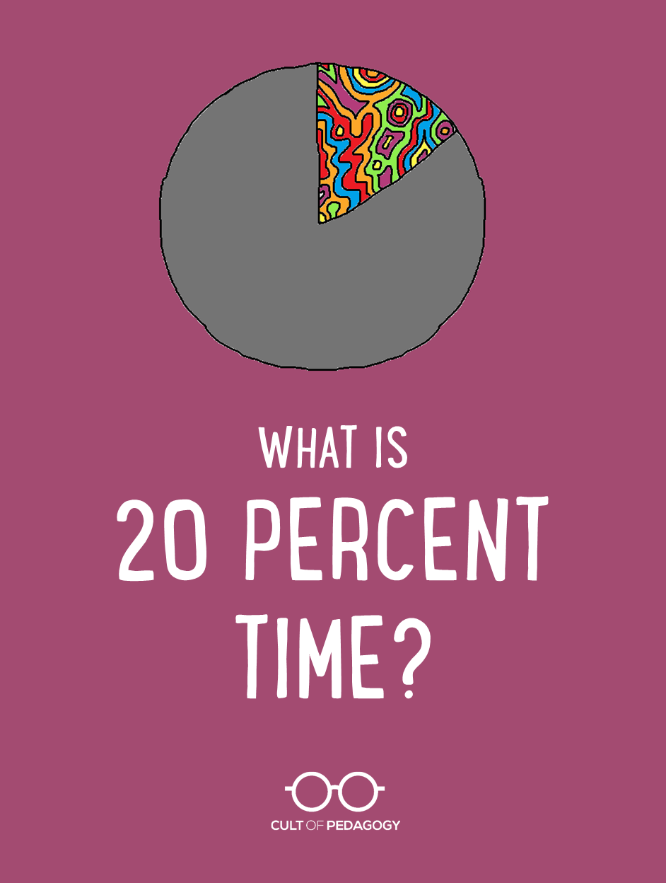
PBL Using 20% Time
Tomorrow: 9:15am

Slide 13
Common Concerns in PBL
Students lose interest
Discipline issues
Time management
Lack of Resources
Non-supportive administration
Managing groups
Student Apathy

Slide 14
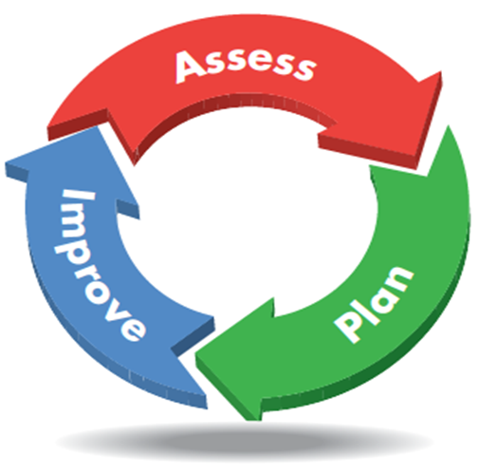
Assessment
Formative & Summative

Slide 15
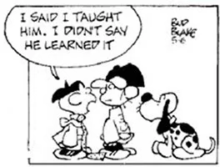
Assessment Strategies with PBL
How do students demonstrate mastery of the JAG Competencies? How do you prove they know what they know?

Slide 16
Formative Assessment

Slide 17
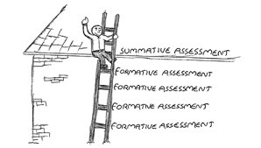
Summative Assessment

Slide 18
Utilizing Rubrics

