Slide 1
PBl 101 Training
June 26-27, 2017
Karey Webb, Instructor
Roosevelt High School
Des Moines, Iowa

Slide 2
introductions Thank you PBL Prospectors * Missy Boutwell, Erin Whipple, Jeremy White PBL Prime Movers

Slide 3
Group Norms & Housekeeping
Be on time
Be present
Be a good collaborator
Will you do what you expect your students to do?
Be aware of your “air time”
Lunch
Restrooms
Breaks
Agenda

Slide 4
Learning Outcomes
You will learn how to:
How to create and facilitate PBL in your classroom
How to differentiate between “doing projects” and Project Based Learning
Increase student motivation and improve students’ mastery of 21st Century Skills
Help students see how school connects to the outside world by making learning relevant and meaningful
More effective ways to implement JAG competencies
You will help create an innovative thinker!!

Slide 5
History of Education
Teacher-Centered
“Sage on Stage”
Students listen and do what they are told
Now???

Slide 6
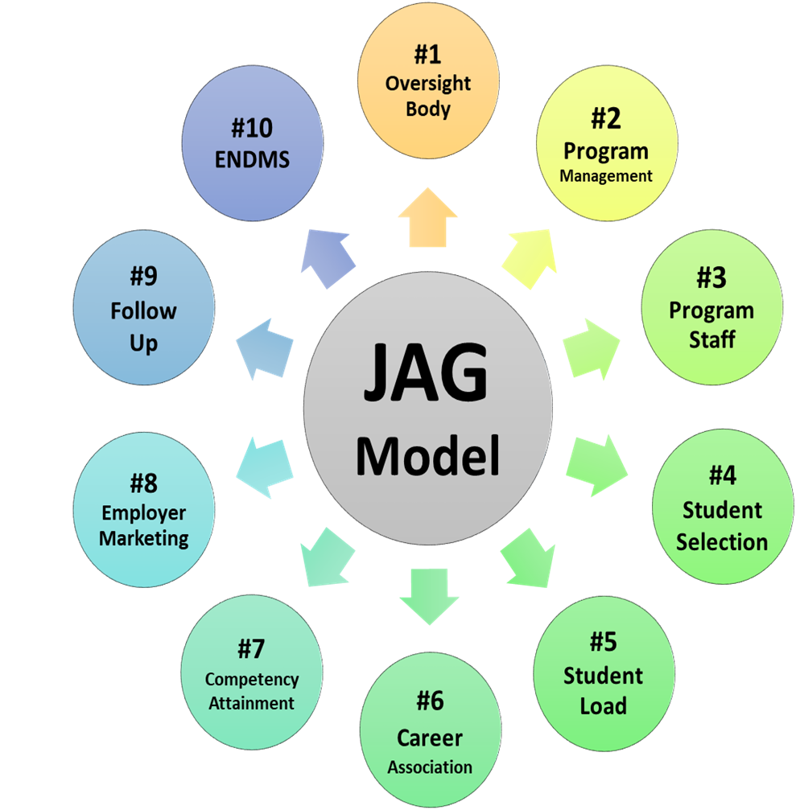
Wheel of JAG

Slide 7
What are Terms for the “Ideal Graduate”?

Slide 8
Notes:
Sketch your partner across from you
How did you feel?
Nervious, timid, afraid… other?
PBL is really hard. There will be times where we are asking students to “Show your sketch” –or be the model.
It pushes us out of our comfort zones!

Slide 9
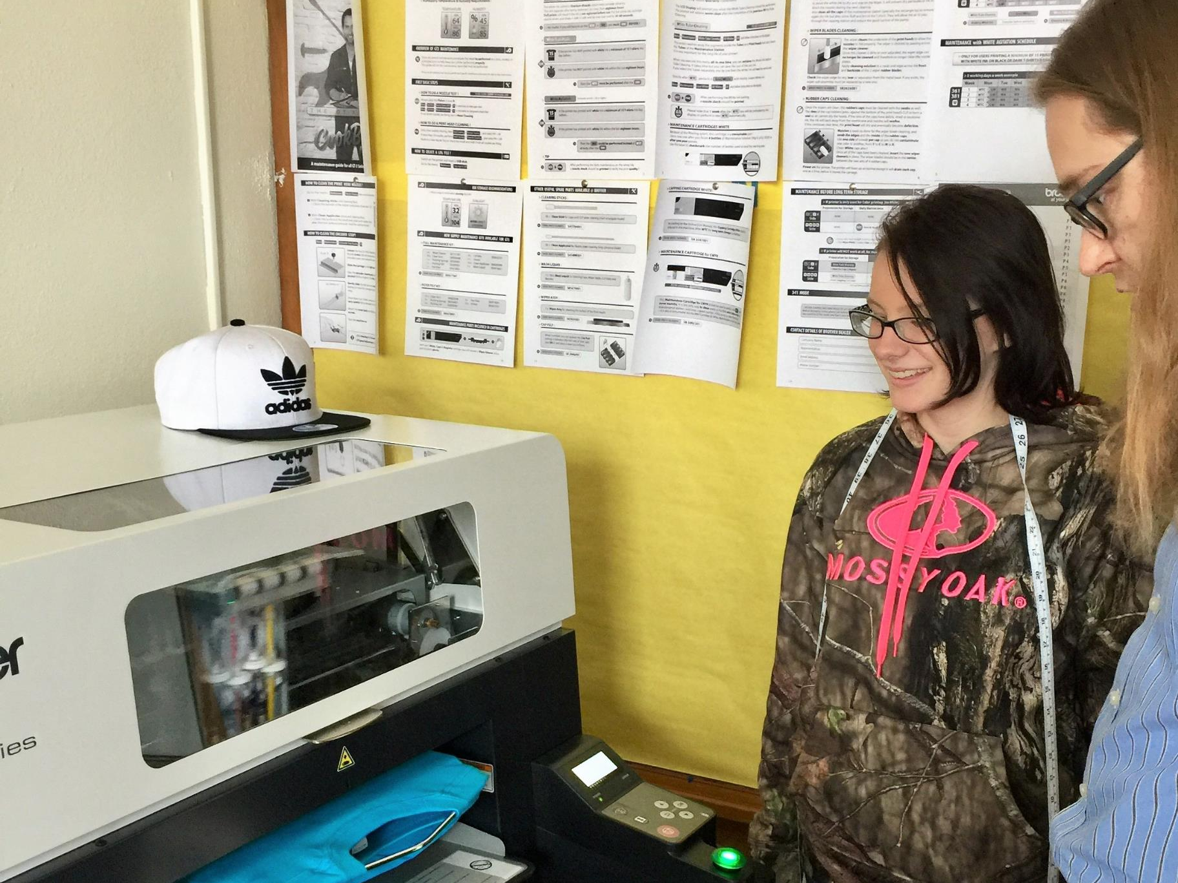
Why PBL?
All grade levels and any subject area
Effective and Enjoyable way to learn and teach
Develop Deeper Learning of Competencies
Success in College, Career and Life
Backed by Research
Educating a workforce that no longer exist

Slide 10
JAG’s Journey with PBL
iJAG + BIE
Exploratory Journey
Menus
Launch NTS 2016
Webinars, NSLA trainings
PBL Bank
Prime Movers
NEXT?

Slide 12
IT’S A MAIN COURSE….NOT A DESSERT!!
NOT a separate teaching method
NOT extra or added to something else
NOT considered “Other”
NOT sometimes or “in-between” Teaching
NOT the same as “making something”
*Collage, Pyramids, Family Tree

Slide 13
Gold Standard PBL: Essential Project Design Elements
Notes:
Article
Count off 1-8
Everyone read up to “Student Learning Goals”
Key Knowledge and Understanding & Key Success Skills
Challenging Problem or Question
Sustained Inquiry
Authenticity
Student Voice & Choice
Reflection
Critique & Revision
Public Product
Read your paragraph, develop poster to represent your assigned element
Share out

Slide 14
Article Gold Standard PBL: Essential Project Design Elements
Count off 1-8
Everyone read up to “Student Learning Goals”
Key Knowledge and Understanding & Key Success Skills
Challenging Problem or Question
Sustained Inquiry
Authenticity
Student Voice & Choice
Reflection
Critique & Revision
Public Product
Read your paragraph
Develop poster to represent your assigned element
Share out Essential Project Design

Slide 15
8 Essential Elements Refined:
Key Knowledge, Understanding, and Success Skills
JAG Competencies
Content Standards, College & Career Readiness Standards
Challenging Problem or Question
The Driving Question or Project Idea
Project is framed around problem or issue
Sustained Inquiry
Authenticity
Extended process of answering questions, finding the answers, researching
Is the project REAL, and ENGAGING for participants?

Slide 16
8 Essential Elements Refined:
Student Voice & Choice
Students makes decisions about project, how they work and/or what they produce
Opportunity to “own” the project
Reflection
Students and Teachers reflect the effectiveness of the project, quality of work, obstacles
Critique & Revision
Students give, receive feedback to improve their process and products
Public Product
Students make their project work public
Must reach beyond the classroom

Slide 17
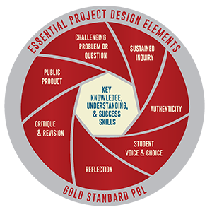
At this moment…
What questions do you have on how to plan effective projects for our students?
Project Ideas/Design
Project Assessment
Project Management
Page 3
Notes:
Brainstorm questions on page. 3 in workbook.
Pick top 3 questions, NEED TO KNOWs
Put them on Board/Paper
Review as training goes along.

Slide 18
Take a look…
Is this a high quality PBL?
Use Essential Project design Elements Checklist on pg. 22 of appendix

Slide 19
Medical Intern PBL

Slide 20
What do you think?
Notes:
Think, Pair, Share on reflection to Medical Intern video.

Slide 21
Journal Reflection

Slide 22
Lunch Break!!!!!

Slide 23
Let’s Keep Moving!!

Slide 24
Unforgettable.

Slide 25
Where do I Begin?
What is happening in my community?
What are the interests of my students?
What skills do my students NEED to DEVELOP before they enter the workforce (or college, or life after high school, etc.)?
Workbook, page 2

Slide 26
Table Talk…
What are some ideas for a PBL topic?
Sources of Inspiration
Your Community
Current Events
Real-World Problem
JAG Comps
Your Students
Your Colleagues
Page 7

Slide 27
3 Steps to a Successful Start
1. Brainstorm ideas
2. Specify intended goals and outcomes
3. Decide on Scope and Sequence of project
Specify Goals for Learning – where are you going?
Scope of Project – what are you working with?
Page 2

Slide 28
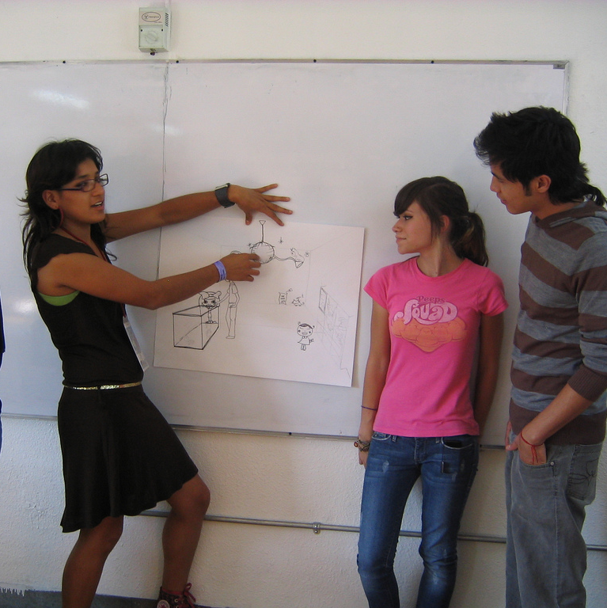
Public Product
Beginning with the “end in mind”
Final “product” should be tangible, presentation of a solution or answer to a driving question
Increases motivation and quality
Stakes are high
Work is taken seriously
Products are displayed for an audience
Bar is raised
Page 9
Notes:
Review Public Product ideas on Page 8 in workbook. Are there additional ideas?

Slide 29
https://www.slideshare.net/jaimeo/the-backwarddesign

Slide 30
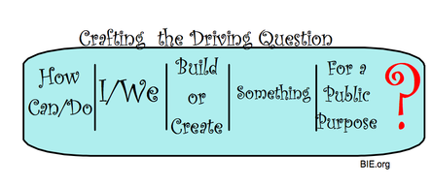
A driving Question
Guides Project Work
Creates or Maintains Interest of the Challenge
Reminds class “why we’re doing this today”
AUTHENTIC
Page 4-5

Slide 31
Charrette Protocol
Charrette Protocol | Time
PRESENTATION Presenter presents their project idea and DQ to a partner. The partner listens. | 3 min
FRAMING QUESTION Presenter asks a specific question to frame the feedback. i.e. “What can I make better about…?” “How can I improve…?” | 1 min
FEEDBACK Partner gives suggestions. Presenter listens Make sure your feedback is helpful, specific, and kind. | 2 min.
OPEN DISCUSSION Presenter and partner have a dialogue about the suggestions/feedback | 2 min
TOTAL | 8 min

Slide 32
Creating an Entry Event
Spark student attention
Start off with a BANG!
Increases project buy-in
Page 6

Slide 33
The Break-up Letter

Slide 34
Voice & Choice
What opportunities will students have to make decisions about the project, product(s) or process?
How will students know when to share their input vs. what has already been determined?
When should the student voice and choice be incorporated?

Slide 35
Pg. 10

Slide 36
What will my students/teams create?
 | Product
Focus | Same product, same focus Presentation, water quality in our region | Different product, same focus Presentation/photo essay, water quality in our region
 | Same product, different focus Presentation, water quality in various parts of our region | Different product, different focus Presentation/photo essay, water quality in various parts of our region

Slide 37
PBL METHODS
Individual
Group
Combination

Slide 38
Teaching PBL
GROUP SESSION
Choosing your student groups
Share Top 3 reasons WHY you chose them
Page 31

Slide 39
If you do it right…
Bring learning to life!
Can work with all kinds of students
Improve students motivation to learn
See how school connects to the outside world
Integrate technology
Teach JAG competencies

Slide 40
Journal Reflection
Review Project Path
Reflection

Slide 41
This area is a little sticky ?
Confident
Sticky
????
Project Design Elements-
What element/elements do you feel are most comfortable for you? Why?
What areas do you need more clarification? Just not “getting it”... Say more?
Other questions, comments or concerns

Slide 42
PBL 101 Training
Welcome Back to Day 2!
June 26-272017
Karey Webb, Instructor
Roosevelt High School
Des Moines, IA

Slide 43
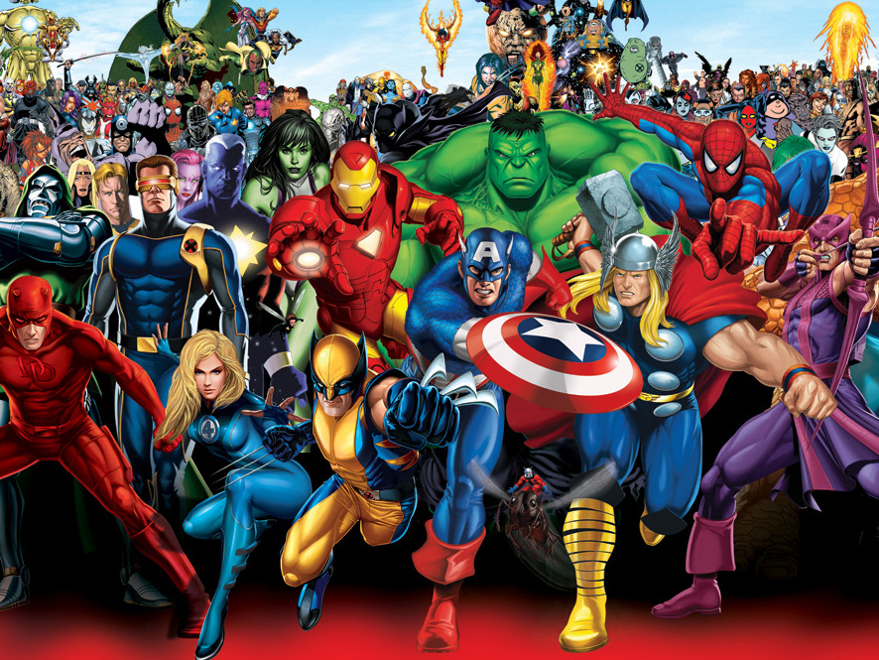
ACTIVITY TIME!!
SUPER HERO SMOOTHIE!!!
What is one thing your feel you can bring to your JAG classrooms?
Notes:
Think of a Super Hero. What is their super power?
How will you work as a team to use your super power to make a smoothie?

Slide 45
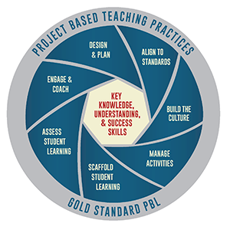
7 Essential Teaching Methods – things YOU DO to make a project successful
1. Design & Plan
Where you create your PBL from start to finish: Entry Event, Implementation, culmination
2. Align to Standards
Using your JAG competencies, Common Core/Content Area Standards
3. Build the Culture
Get student “buy in”, assign student roles
4. Manage Activities
Organize tasks, deadlines, resources, reflection, revision & critique
5. Scaffold Student Learning*
Lessons, tools and instructional strategies to support ALL students in reaching project goals
6. Assess Student Learning
How you test their knowledge, work ethic, team dynamics
Develop your grading system, rubrics
7. Engage & Coach
Coaching, Redirection & Encouragement
Pg. 11

Slide 46
Common Questions for Teaching PBL
Do I just turn students lose once the project starts?
NO You are the coach/facilitator to keep them on track with the driving question
How do I mix lessons with independent project work time?
DEPENDS on the nature of your project, students, your own style
I’m a good lecturer, so can I still do PBL?
RESIST the urge to talk over a period of days
Can I still use traditional tools like worksheets, homework and quizzes?
YES as long as students stay on task
*REMEMBER IN PBL, THE PROJECT IS WHAT ORGANIZES THE USE OF TRADITIONAL TEACHING TOOLS

Slide 47
 | Simpler | More Complex
Duration | 10-15 contact hours | 20+ contact hours
Breadth | One subject | Multiple subjects
Who’s involved | One teacher | Several teachers; outside experts and organizations; people in the community or different areas
Where it takes place | Classroom, School | On and off campus
What products are being created | One product that does not require too much time and advanced skills or tools | Multiple or elaborate products
Student autonomy | Teacher-defined; tightly managed | Co-defined and managed
Technology to be used | Fewer and familiar tech tools | Several tech tools that require new learning

Slide 48
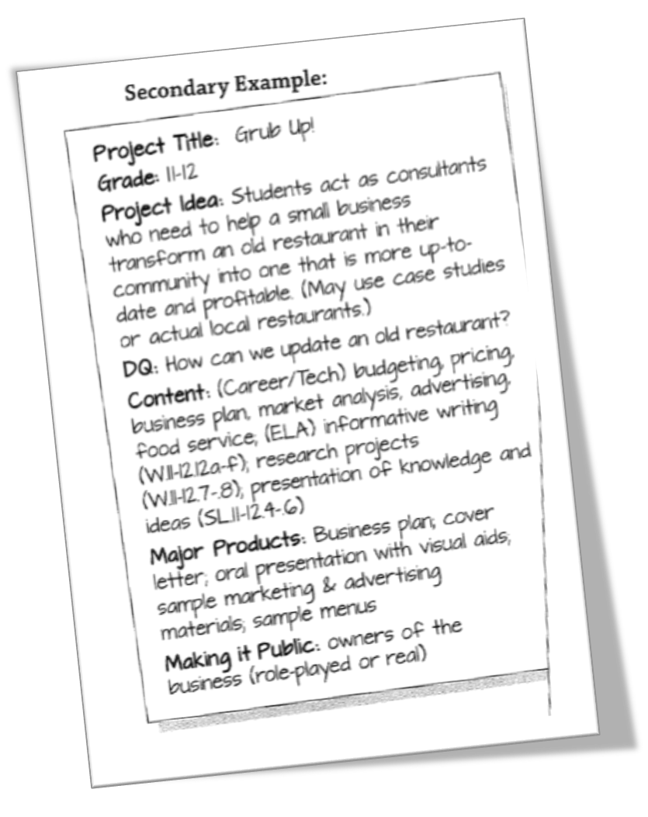
Let’s make it public…
Project Title
Grade
Project Idea
DQ
Content
Major Product(s)
Making it Public

Slide 49
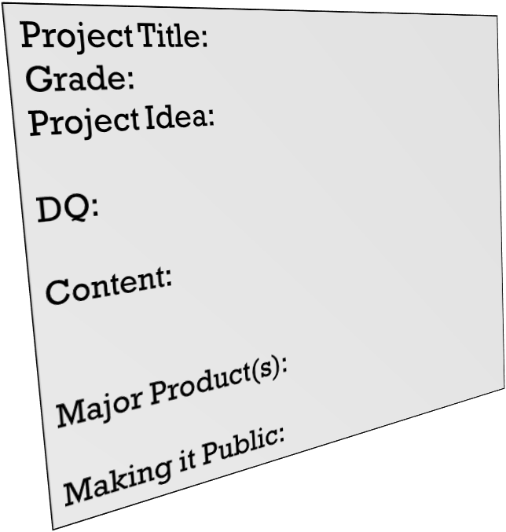
Creating your PBL for presentation
Using your project outline,
Create your PBL!!
Draw/Write out your project using ALL 8 elements onto your sticky pad poster
Hang up your project when complete (gallery)

Slide 50
The Butterfly Effect

Slide 51
Gallery Walk
Using sticky notes, provide feedback on each project design
“Praise” – why you like it; why it is a strength
“Question” – Ask questions about unclear areas
“Polish” – a suggestion for improvement
*Make sure your feedback is helpful, specific, and kind
Notes:
Give a Praise
Ask a question
Polish Method

Slide 52
Reflection
Look at your feedback
-Don’t take it personally!!
Make revisions, additions, corrections to your project
Page 12

Slide 53
Authenticity
What makes a project Authentic?
Read Blog, Page 26

Slide 54
How do I pull it all together?
Ask the experts…
Scaffolding lessons
Managing Groups
Connecting the Community

Slide 55
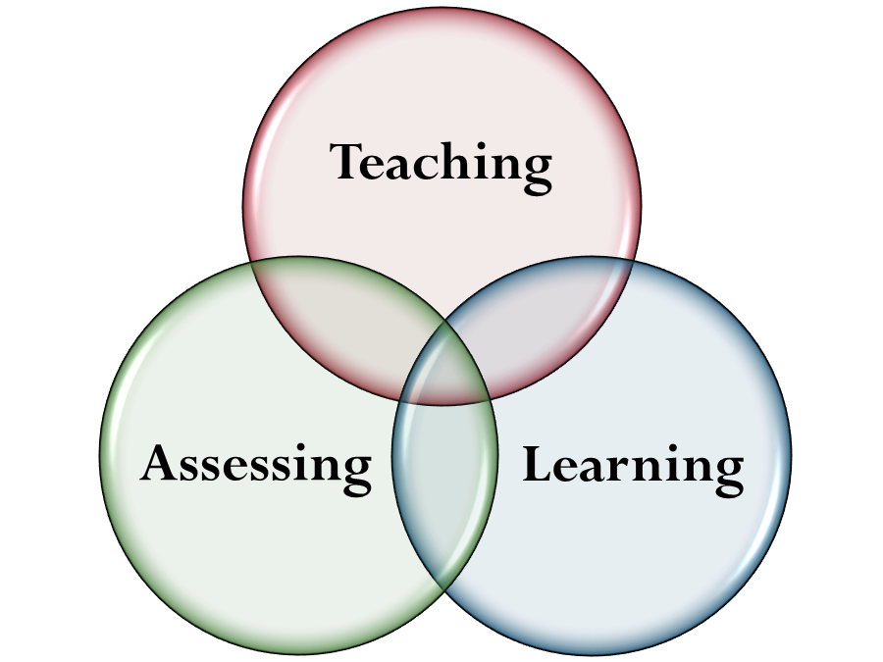
Assessments
Formative
Checkpoints along the way to make sure students are on the right track
Several
Summative
Major, final product
One
Page 24 - 25

Slide 56
Media Saves the Beach

Slide 58
Project Assessment Map
Begin with the end in mind…
“What will be your Final Product/Summative Assessment?”
Key Knowledge, Understanding and Success Skills – JAG COMPETENCIES
“What will the students need to learn in order to create the major product?”
How can they demonstrate Mastery – Level 3?
Formative Assessments
“What do you need to formatively assess ALONG THE WAY? Then, how will you conduct that assessment?”

Slide 60
Managing the Process
First Days of Project:
Conduct the Entry Event
Driving Question
Review Final products
Start Student Questions List
Project teams formed
Discussion of expectations for teamwork
First team meeting: team-building activity, contract, initial task list
Project Wall – Keep yourself organized!
Driving Question
Need to Know – list of questions
Word/Concept List
Project Calendar
Rubric(s) Sample products
Page 10-11

Slide 64
Final PBL project
Write up your project in the PBL Project Overview (pg.27)
Get into groups of 3
Using the Tuning protocol present your project with your fellow Specialists

Slide 65
Tuning Protocol | Time
PRESENTATION Presenters explain their project; Audience listens. | 5 min
CLARIFICATION Audience asks short clarifying questions; Presenters respond. | 2 min
ASSESSMENT Audience quietly uses Project Design Rubric to assess the project; Presenters wait. | 1 min
“I LIKE…” Audience shares what they like (Best Practices); Presenters listen. | 3 min
“I WONDER…” Audience shares concerns (Lacks Features or Needs Development); Presenters listen. | 3 min
REFLECTION Presenters reflect on useful feedback; Audience listens. | 3 min
“I HAVE…” Audience shares ideas & resources for the project; Presenters may respond. | 3 min
TOTAL | 20 min
Page 13-14

Slide 66
Questions/Feedback

Slide 67
PBL resources
www.bie.org
www.jag.org/jag-library
Workbook
E-mail: pbl.jag@gmail.com
Facebook: @pbl.jag
Twitter: @pbljag
Pinterest: @pbljag

Slide 68
www.bie.org

Slide 70
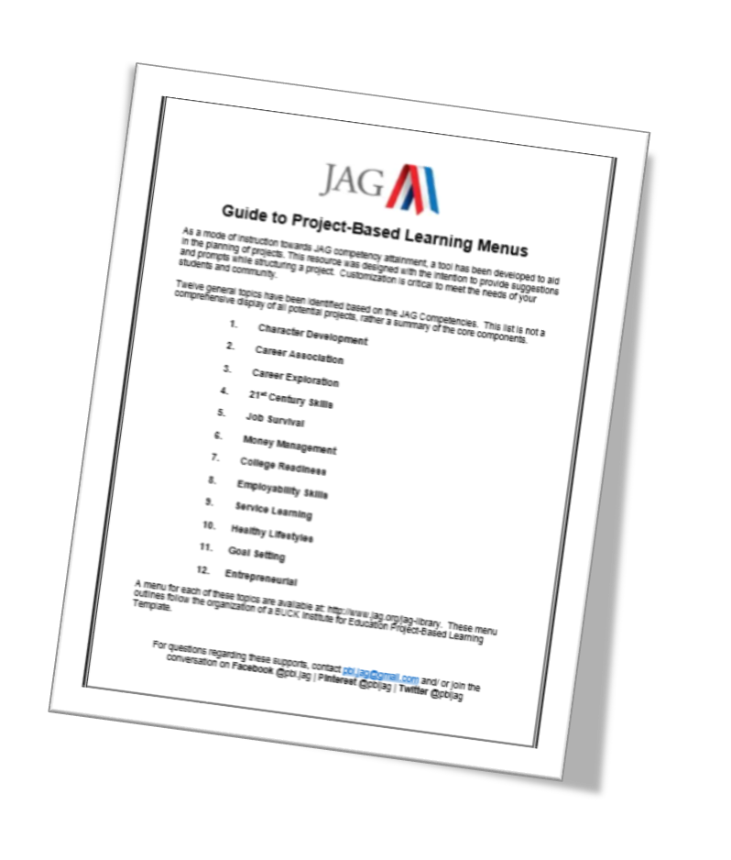
PBL Menus
Character Development
Career Association
Career Exploration
21st Century Skills
Job Survival
Money Management
College Readiness
Employability Skills
Service Learning
Healthy Lifestyles
Goal Setting
Entrepreneurial

Slide 71
Please take a moment…
https://goo.gl/forms/rC5McqzMXmO1pash1
Karey Webb
kareybeth.webb@gmail.com
763.245.8008

