Slide 1
Mainely Coffee

Slide 2
Business Pitch
https://spark.adobe.com/video/7yrAcBZrV2dOv

Slide 3
Business Summary
Mainely Coffee solves the problem of the lack of safe and indoor spaces for teens, families, and businesses in Madison to meet and socialize.
Our business is providing a safe indoor space for teens, families, and businesses in Madison.
Mainely Coffee serves coffee and baked goods to Madison’s community.

Slide 4
Market Research
Because 20% of Somerset Counties population is under the age of 18 we believe that our business will thrive in Madison.
Unlike other chains that serve coffee, Mainely Coffee is eco friendly using only reusable cups and we partner with local companies to bring the best to Madison.

Slide 5
Market Research Cont
Mainely Coffee will have what we call Student Hour that will run from 2pm-4pm everyday and will offer special pricing to students when they show their student ID. Not only will we have student hour we will have reusable cups that you can buy and receive discounted coffee prices when you use that cup.
According to US News, Americans spend $2.70 each day on coffee, so our prices are on point. And foodandwine.com says that 62% of adults in the United States.

Slide 6
Marketing Strategy
Mainely Coffee markets to anyone from students to the elderly. With student hour, and senior citizen discounts, we serve everyone! We will use social media such as facebook, instagram, and our website

Slide 7
Financial Plan
Our product will cost money to customers but nothing is more than $5!
We will need $47,00 in order to buy the machines, signs, furniture, advertising, our mortgage, and our internet.

Slide 8
Financial Plan Cont
To make the money we need we plan on fundraising for $25,000 and taking out a loan for the other $22,000
We plan on fundraising by hosting breakfasts, car washes, and selling decals of coffee cups
Mainely Coffee wants to partner with Apple Tree Firehouse bakery because they are a good bakery and our business prides ourselves on partnering with small businesses from Maine.

Slide 9
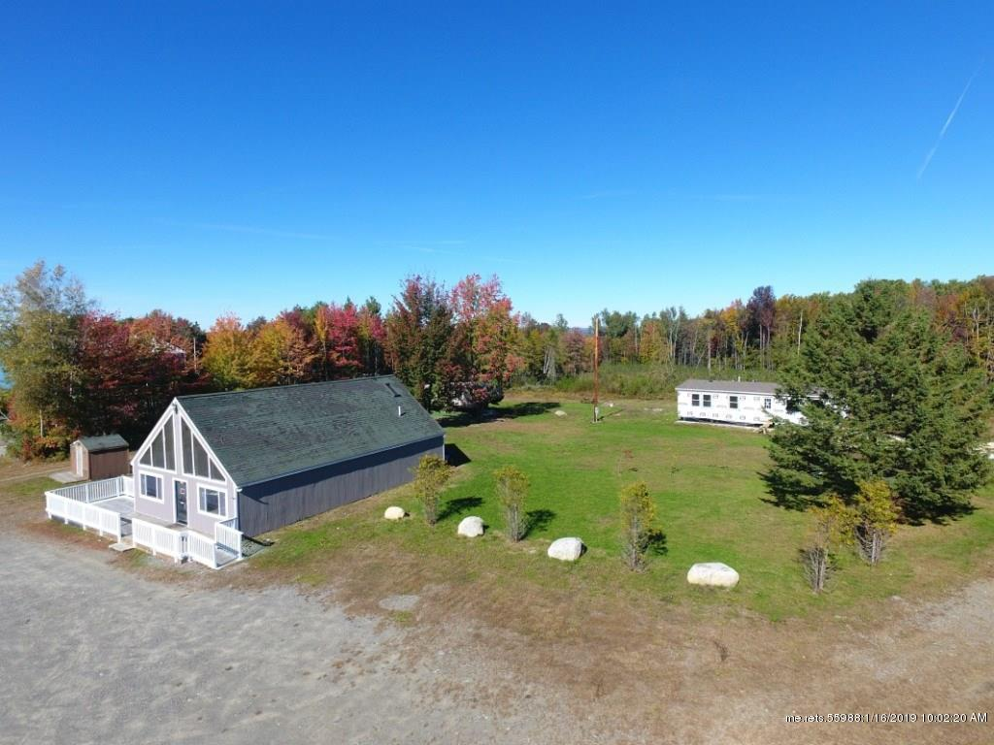
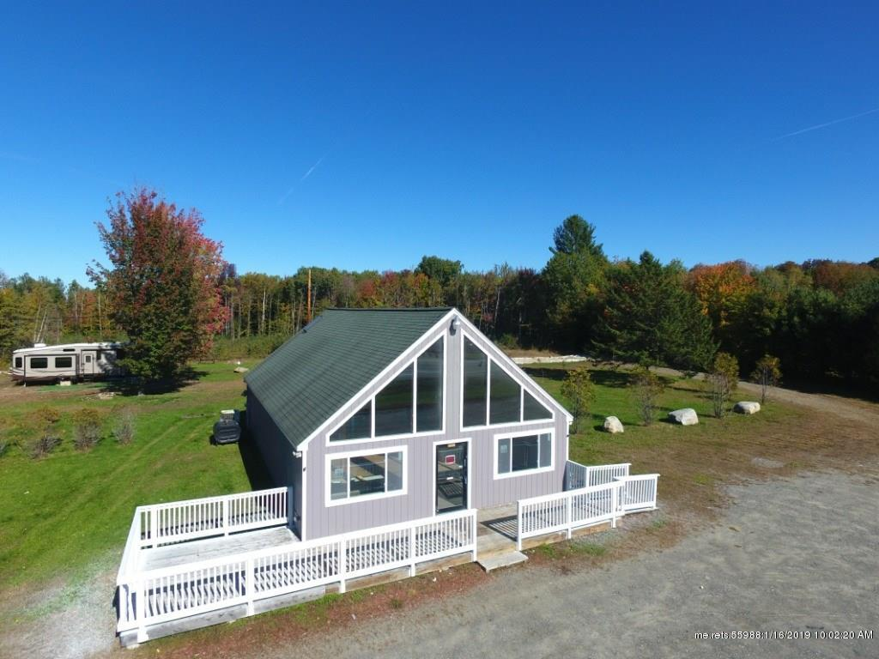
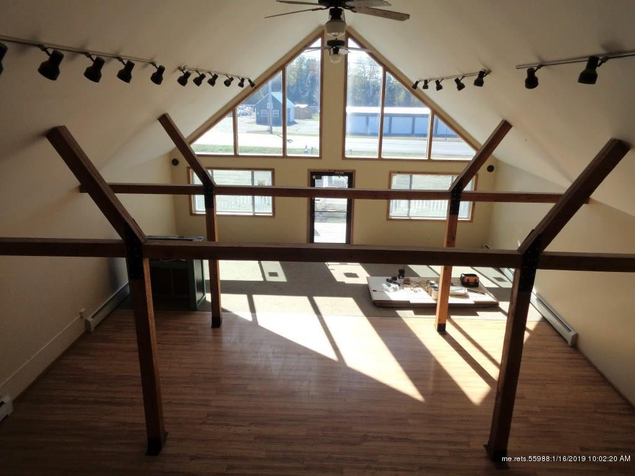
More about Mainely Coffee
Mainely Coffee offers reusable cups to make our environment a little better.
Unlike other companies Mainely Coffee will serve flavors such as pumpkin and maple all year round to satisfy our customers.
Mainely Coffee will be located on the Lakewood Road in Madison by Hight Ford on the Lakewood Road in Madison

