Slide 1
JAG
Career/Professional Association

Slide 2
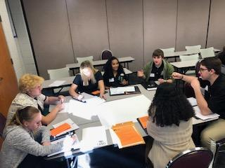
What is the career/professional association?
▸ Student-led organization for
career-minded students
▸ Each student in JAG is
automatically a member of CA/PA
▸ Activities are offered to develop,
practice, and refine skills necessary for personal, academic, and career success

Slide 3
Five Goal Areas
▸ 1. Leadership Development
▸ 2. Career Development
▸ 3. Social Awareness
▸ 4. Civic Awareness
▸ 5. Community Service

Slide 4
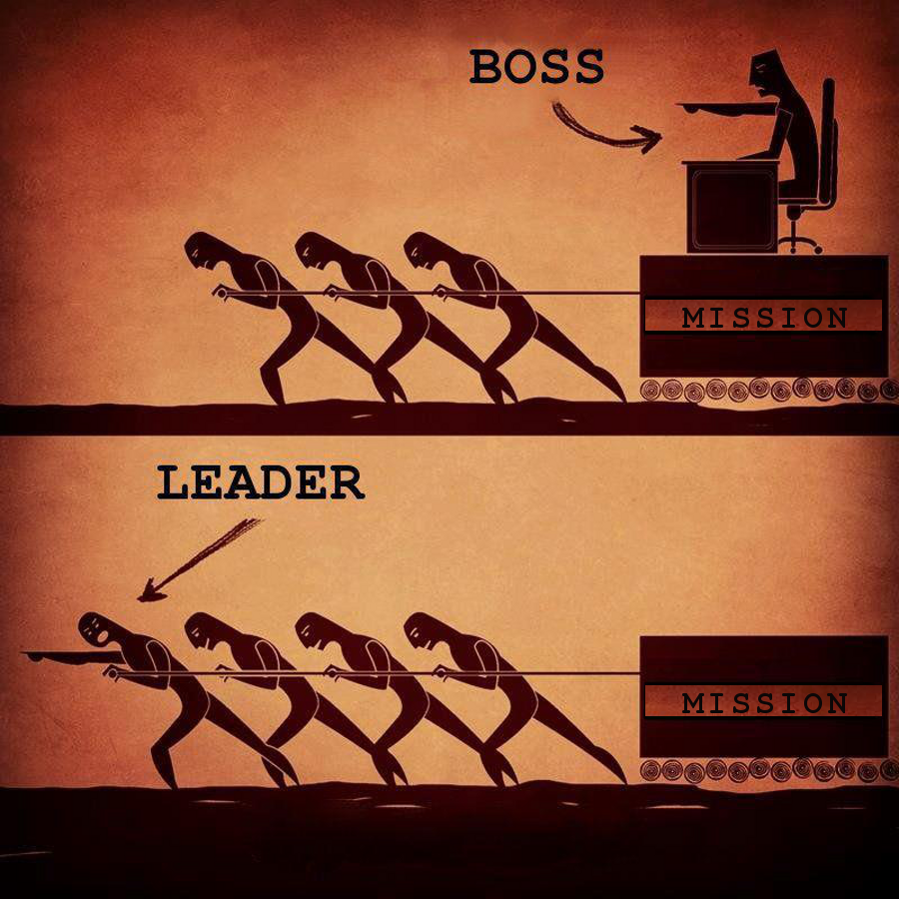
Leadership Development:
activities that improve the skills, abilities and confidence of leaders

Slide 5
Career Development
activities that increase your understanding of particular career fields, building relationships with local employers, gaining employability skills, etc.

Slide 6
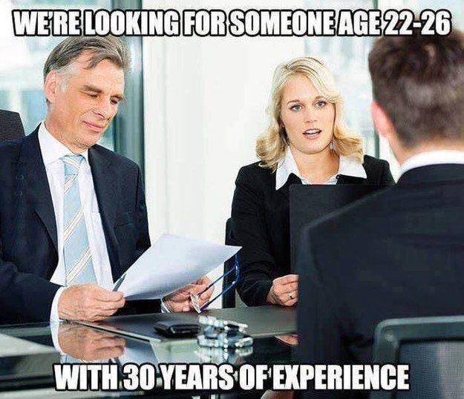
Career Development Continued
▸ Examples: guest speakers, field
trips to their place of employment, judges at local and state competitions, mock interviews
▸ The employers we meet might
offer you a job because they are impressed with your skills!

Slide 7
Social Awareness:
activities that allow us to take the perspective of and empathize with others from diverse backgrounds and cultures, to understand social and ethical norms for behavior, and to recognize family, school, and community resources and supports.

Slide 8
Social Awareness Continued
▸ Ex: electing proper dress for various occasions, how to organize an event, the value of deadlines, how to interact with special guests, proper social etiquette

Slide 9
Civic Awareness
activities addressing issues of public concern. Citizens acting alone or together to protect public values or make a change or difference in the community are common types of civic awareness.

Slide 10
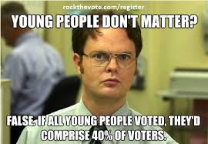
Civic Awareness Continued
▸ Better connect and understand how your community works
▸ Build citizenship skills
▸ Ex: touring local courthouse,
meeting with the Mayor and other government officials, observing a panel of city employees from various departments, bringing awareness to community needs

Slide 11
Community Service:
non-paying activities performed by one person or a group of people for the benefit of their community or its institutions

Slide 12
Community Service Continued
▸ Develop your
helping skills
▸ Give back to
something you're passionate about!

Slide 13
Levels Of Involvement
▸ Chapter involvement
▸ Ex: chapter member or officer, project leader, participant in local fundraising projects, Initiation and Installation Ceremony
▸ State involvement
▸ Ex: Leadership Development Conference (LDC), Career
Development Conference (CDC)
▸ National involvement
▸ Ex: National Student Leadership Academy (NSLA) in
Washington, D.C., speaker at JAG functions

Slide 14
Why Is It Awesome?
▸ Student led
▸ Personal and career development
▸ Learn how to be an effective leader and team member
▸ Interact with members in school, community, state, and national activities, which gives you the opportunity to travel, meet new people, and share ideas

Slide 15
What We Need
▸ President
▸ VP of Leadership Development
▸ VP of Career Development
▸ VP of Social Awareness
▸ VP of Civic Awareness
▸ VP of Community Service
▸ Secretary/Treasurer
▸ Social Media Master

Slide 16
Get Involved!
Do you want to be an officer? If not, what committee would you want to be in?

