Slide 1
Disability Sensitivity Training
Notes:
Welcome and introduce self

Slide 2
ACTIVITY Directions- Connect all the dots with 4 straight lines. Do NOT lift your pencil off the paper. Do NOT retrace any lines. Lines may cross if necessary.
Can you do it?
Is it possible?
Notes:
Hand out sheet- have them solve puzzle- give a couple minutes

Slide 3
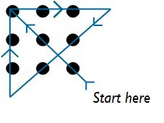
Solution
Notes:
Solution- talk about going outside the norm to solve different problems.

Slide 4
Discussion
Why don’t most of us think outside the boundaries?
We had to draw outside the lines. This is what is required of us when we interact with others as everyone thinks differently. (outside of our boundaries or box)
Why is it so hard to understand others points of views?
HINT: We are often so busy thinking about our own point of view, that we fail to see others’ point of view. In addition, we tend to judge others ideas rather than understand them.
Notes:
Ask questions- get engagement

Slide 5
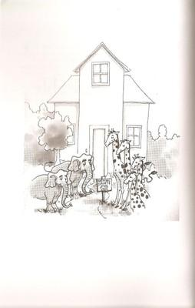
Opening up new dialogue
The fable by Dr. R Roosevelt Thomas
The personified giraffes and elephants
Notes:
Summarize Fable:
Giraffe just built a new ergonomically correct house and was very excited when his friend the elephant came over to visit so he could share.
Giraffe invited elephant in and asked him to come see his woodshop in the basement. Elephant attempted to go downstairs but really struggled fitting through the narrow tall stairway. The steps creaked from his weight as he went down.
Once downstairs giraffe got a phone call and had to run back upstairs saying he would be right back to Elephant.
Elephant decided to look around and as he tried to squeeze through a doorway and got stuck in a doorway. As he tried to squeeze through he got stuck and as he was struggling to get out. As he was struggling to get out he hit a table with a bunch of tools that crashed down. He jumped back and bumped into the table saw knocking over a stack of wood. Giraffe ran down the stairs after hearing the loud crashes.
Giraffe yells at his friend Elephant, what are you doing to my woodshop? This woodshop is ergonomically designed and state of the art, you are completely messing it up. I like to hang out with you, but you need to start exercising and eating healthier so that you can lose some weight and fit into my woodshop. You could also take ballet so you are lighter on your feet.

Slide 6
Lessons to consider
STOP- trying to change the elephant
START- focusing on changing the house
Continue to focus on inclusion

Slide 7
Inclusive conversations
Inclusive Language
The term “inclusive language” refers to the conscious use of specific words in both speech and writing in order to avoid stereotypes
Inclusive language requires a speaker or writer to avoid any statement that may cause offense

Slide 8
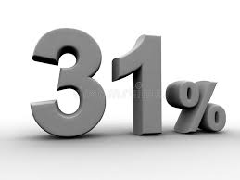
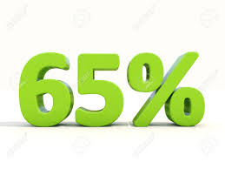
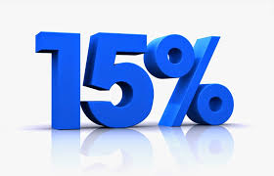
Why is this important
Report discrimination
Employed w/disability
Can’t find job
State unemployment rate
4%
of Americans have disabilities
of individuals with disabilities were born with them
Unemployment rate for individuals with disabilities
Notes:
19% of Americans have disabilities, making it the largest minority population in the United States
15% of individuals were born with their disabilities where as 85% acquired them
According to the offices of persons with Disabilities: Iowa’s unemployment rate is at approximately 4% where as unemployment rate for Iowans with disabilities is at 9.6%.
Why do you think there is a discrepancy?
Nearly half (40%) of employed people with disabilities still report experiencing some form of job discrimination.
Approximately 65% of people with disabilities who want to work and can’t find a job.
Nationwide, 29% of people with disabilities were working in Dec of 2016 and it raised to 31% in December of 2017 thanks to heightened awareness.
Statistics came from:
•CSAVR
•Iowa office of Persons with Disabilities
•Kessler Foundation and University of New Hampshire Institute on Disability

Slide 9
Myths, Misconceptions and Realities
True or False
Cancer, diabetes, AIDS, epilepsy, dyslexia and mental illness are examples of “hidden” disabilities which are covered by the Americans With Disabilities Act.
Notes:
True

Slide 10
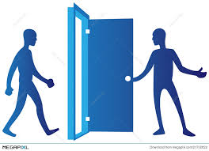
Myths, Misconceptions and Realities
True or False?
If someone has a disability and appears to need help, it is polite to provide assistance before you’ve been asked.
Notes:
False, ask the person first

Slide 11
Myths, Misconceptions and Realities
True or False?
Considerable expense is required to accommodate employees with disabilities.
Notes:
False-most accommodations cost under $500.00.
Example:
We had a call from a bank in the state of Iowa to assist with an employee who was missing a lot of work due to migraines. Our Assistive Technology specialist went in and assisted the bank so that their employee could maintain employment. The accommodations made were:
1.A few of the fluorescent light bulbs were removed from the overhead lighting to reduce the brightness of her work area. (free)
2.There was a blue light blocking screen protector that was purchased for $50.00
3.The last accommodation was noise blocking headphones to reduce noise at work. ($450.00)
The purchase of these items allowed the trained current employee to stay in her position for $500.00 with no more lost time from work. Saving the bank from having to hire a new person for the position which would have cost them 150% of that position’s salary.
Another example was an employee who we were working with was struggling with back pain. Due to his disability he had a chair that he had specially designed for him and he didn’t want to purchase a new chair but needed more lumbar support. In order to accommodate this the employee now has a pool noodle ($1.99) as back support on his chair. A very inexpensive accommodation that now allows him to work at his desk without the pain in his lower back.

Slide 12
https://www.youtube.com/watch?v=Gv1aDEFlXq8&t=1s

Slide 13
Language Etiquette & Customer Service
Person First
Preference of the person
Don’t be afraid to ask
Don’t make an assumption based on the “label”
We all have biases-it is how we respond that counts
Work to ensure respect, sensitivity, access and effective communication

Slide 14
Inclusive conversations
Setting:
Assume good intent- these are teachable moments
Asking for clarification to seek understanding
Know that mistakes happen, apologize, forgive, fix and move forward
Tone- this is a judgement free zone
Understand education is key
Get comfortable with the uncomfortable
Notes:
Discussion on fears of saying or doing the wrong thing. This is common and should not be shamed.
Example:
An employee has a blind supervisor and greets everyone in the office with “Good morning, good to see you!” When the employee reaches the supervisor she is afraid to offend them and doesn’t know how to greet the individual as she doesn’t want to say good to SEE you. After some time the employee approached the supervisor and explained her fear. The supervisor explained to the employee he said that he is more offended when others don’t greet him. He stated that he also says “see you later” and that stating that to him is not offensive to him.

Slide 15
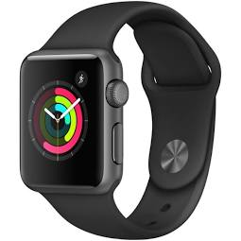
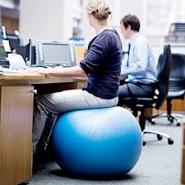
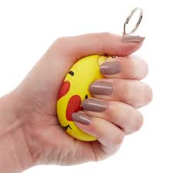
Universal design
Can you share some ideas of technology or accommodations that allow for access for all individuals?
Notes:
(This is a good one to break people into groups to talk about this. Activity where the group who comes up with the most will win)
Cell phone-Voice to text, Voice command, Task list and reminders, Siri, Zoom in, Calendar, several Apps, Text vs Phone for communication, money scanners for vision loss, picture task list on phone, Notes option for those who may forget steps on a position, etc. These are things that we use every day but for many individuals these are accommodations that they have access from anywhere that does not cost anything for an employer.
Apple Watch-can watch heart rate, assist with weight loss, assist with reminders including task reminder, movement reminders, etc.
Exercise Ball Chair-Often used for individuals who need to strengthen core muscles or student/adults with ADHD.
Stress ball-can assist some individuals with stress or anxiety as a noninvasive or intrusive accommodation. This could be a hidden accommodation that can be placed in an individual’s pocket.
A few other common accommodations that are now used for many individuals for ease of access include: Escalator, Elevator, conveyor belts, automatic doors, fatigue mats, etc.

Slide 16
Disability
What picture comes to mind when I say a person with disability?
Notes:
Disabilities may or may not be visible to others.
Many individuals think of someone who is going to need extra help or is less capable, or less intelligent.
Look around this room, 1 of 4 individuals in this room either have a disability or will acquire sometime in their life. Anyone can join this largest minority population at any time.

Slide 17
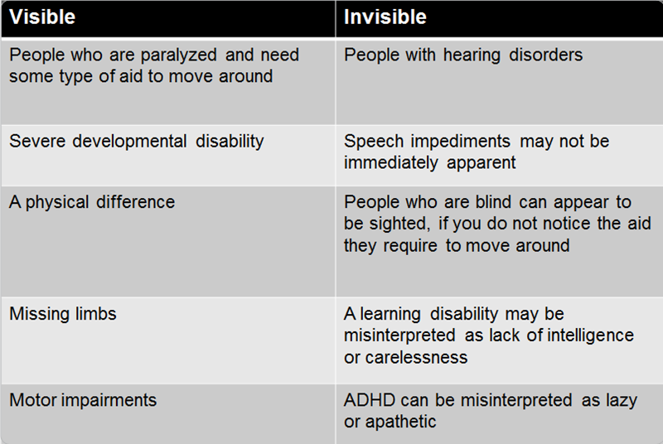
Visible vs Invisible

Slide 18
Did you know?
Salma Hayek-Actress
Fools Rush in and Wild Wild West, Outstanding Actress Nomination
Most recently in The Hitman’s Bodyguard with Ryan Reynolds
Notes:
Diagnosis
Dyslexia-Diagnosed in her teens and at age 25 was unable to read a street sign
“I’m very lucky I didn’t have it easy because I have learned so much figuring it out on my own and having to create things for myself.”
Having reading issues doesn’t bother me anymore.
Dyslexia Accommodations:
Not necessarily just numbers or letters. It could be one or the other or a combination. Sometimes this is as simple as changing b’s to d’s while other times the words may seem completely scrambled.
Books on tapes
Screen readers
video’s versus training manual
voice to text
Siri
Provide directions in one step at a time
Sensitivity
Do not assume that because someone has a cognitive impairment, such as a learning disability or dyslexia, that they are below average intelligence. The individual may have above average intelligence, but may have difficulty receiving, expressing or processing information.

Slide 19
Did you know?
Steven Hawking-Theoretical Physicist
Notes:
Diagnosis
Steven Hawking has ALS. -- specific form of multiple sclerosis
In 1963, Hawking contracted motor neuron disease and was given two years to live. Yet he went on to Cambridge to become a brilliant researcher and Professorial Fellow at Gonville and Caius College. From 1979 to 2009 he held the post of Lucasian Professor at Cambridge, the chair held by Isaac Newton in 1663. Professor Hawking has over a dozen honorary degrees and was awarded the CBE in 1982. He is a fellow of the Royal Society and a member of the US National Academy of Science. Stephen Hawking is regarded as one of the most brilliant theoretical physicists since Einstein.
Don’t make assumptions on what an individual may need for accommodations. We will give you a few suggestions below but remember it is not one size fits all. Just because a person is in a wheelchair does not mean they will have limited hand and arm mobility. Accommodations should be individualized for the person in need.
Accommodations for individuals with mobility issues:
Wheelchair
Uncluttered work area
Height adjustable desks and furniture
Accessible bathrooms (make sure that there is a turn around radius, sinks, hand dryers/towels, soap dispenser, etc at a height that is accessible for individuals in wheelchairs
Computers with speech input
An open mind to alternative ways to do a job (example: Could a person do the job from home if the location is inaccessible, if the work area is upstairs and there is no elevator could the workspace be moved to the main level, etc)
Access to accessible parking spaces including wheelchair ramps or curb cut outs for entrance.
Upon hiring a person who has an obvious mobility impairment, offer to provide a tour and evaluate the worksite for accessibility.
Make workplace accessibility changes according to the specific work-related needs of the employee, making workspace modifications, keeping paths clear, and positioning items at appropriate reach heights, etc.
When hosting events outside of your facilities make sure the locations are accessible and design activities that include all employees.
Sensitivity
Don’t assume:
Steven Hawking is a very intelligent and accomplished man. Do not assume that because a person has physical limitations they are unable to complete certain tasks. These individuals may have assistive technology that you are unaware of that will allow him/her to do tasks in a different way.

Slide 20
Did you know?
Jessica Alba-Actress
Fantastic Four-Won Favorite Female Movie Star
Notes:
Disability
Diagnosed with Obsessive Compulsive Disorder and Anxiety
Jessica stated in an interview ”I used to unplug every single appliance in my house. Or I’d double-check every door in my house to make sure it was locked at night.” “It was like a panic came over me and I had to do something, and once I did it, I was OK. … It was really me needing to control something.”
Jessica said she believes that her OCD has actually made her and other actors more successful in Hollywood.
"I can be a little obsessive compulsive about things, but that just means that when I do things, I do them proficiently and I do them to the best of my ability,". "I think a lot of actors have OCD. I think it's part of being creative, whether your outlet is acting or science or math. Whatever it is, it takes some sort of drive to get anywhere."
Accommodations for mental health disorder which may include multiple diagnosises: As you will note as we go through this list many of these accommodations are ones that the employee is able to do independently.
Self-Paced workload
Additional time to learn new responsibilities
Flexible hours
Frequent or longer breaks with backup coverage
Telephone calls or time off to consult with doctors or other supports like counseling and therapy
Allow employee control of their workspace
Allow employee to take break and use stress management technique
Allow employee to tap record meeting and/or provide typed minutes
Support animal
Allow working from home
Handle problems before they arise
Divide larger assignments into smaller goals
Do not require work related social functions
To Do lists with check offs as they are completed
Move employee to private area with less distractions
Access to listen to music or sound canceling headphones
Procedure to assess if accommodations are working
Sensitivity
Don’t assume that individuals with mental illness are unable to get work done or are not productive given their rituals. Do not assume that mental illness means a person is crazy. They may view things in a different way however this could add to your teams creativity and innovation.

Slide 21
Did you know?
Michael Jordan-NBA Basketball Star
Notes:
Diagnosis
Michael Jordan often refers to his diagnosis of ADHD as a gift he shared with Albert Einstein.
Forbes magazine ranked him among the top 20 most powerful celebrities in the world. This distinction reflects his success not only as an athlete, but as an entrepreneur–the preferred career path of those with ADHD.
Accommodations
Fidget activities/things to do with their hands/body. –Examples: Fidget spinners, pedals under desk, stress balls, etc.
Divide large assignments into smaller tasks
Set timer or alarm
Provide checklist of assignments
Electronic organizer or apps
Calendars
Color coded system-each color represents a task or level of importance
Written instructions
Additional training time for new tasks
Use a flowchart to indicate steps
Noise cancelling headset
White noise machine
Quiet area to do work
Structure breaks
Allow employee to work from home
Use of a computer
Spell check and grammar check
Sensitivity
Do not assume that a person with a disability on has negative affects from that disability. The stigma of ADHD is that individuals with the disorder are disruptive, have an inability to pay attention, and are unable to sit still.
Not every person with ADHD has the same personality traits, but there are some personal strengths that can make having the condition an advantage, not a drawback. Examples of these traits include:
energetic: Some with ADHD often have seemingly endless amounts of energy, which they are able to channel toward success on the playing field, school, or work.
spontaneous: Some people with ADHD can turn impulsivity into spontaneity. They may be the life of the party or may be more open and willing to try new things and break free from the status quo.
creative and inventive: Living with ADHD may give the person a different perspective on life and encourage them to approach tasks and situations with a thoughtful eye. As a result, some with ADHD may be inventive thinkers. Others words to describe them may be original, artistic, and creative.
Some people with ADHD may become hyperfocused. This makes them so intently focused on a task that they may not even notice the world around them. The benefit to this is when given an assignment, a person with ADHD may work at it until its completion without breaking concentration.

Slide 22
Did you know?
Dan Aykroyd-Actor
Ghostbusters, Blues Brothers 2000, My Girl
Notes:
Disability
Dan Aykroyd had a diagnosis of Asperger’s. Aykroyd stated in an interview with The Daily Mail, his Asperger syndrome contributed to the inspiration for the hit movie Ghostbusters, telling the Daily Mail, "One of my symptoms included my obsession with ghosts and law enforcement -- I carry around a police badge with me, for example. I became obsessed by Hans Holzer, the greatest ghost hunter ever. That’s when the idea of my film Ghostbusters was born.“
Accommodations
Individual with symptoms on the spectrum including Autism and Aspergers are much like the rest of us. They will have unique gifts, interests, and accommodation needs. As mentioned before not all accommodations listed in this section will relate to an individual you are working with. These are a few examples of accommodations that can be put in place.
Noise Canceling headphones
Quiet environment with few distractions
Sensory item that may help them self-calming (i.e. stress ball, piece of cloth in their pocket, fidget)
Mentor to assist with newly assigned job tasks
Job coach
Concrete expectations
Training videos demonstrating expectations
Allow for alternative modes of communication (ie-Text messaging, email, conversation, etc.)
Alternative lighting (lamp to brighten work area or to allow for darker work area vs fluorescent lighting)
Advanced notice of meetings or changes in duties
Sensitivity
that people with Autism are slower than others or are unintelligent
Please always keep in mind that communication difficulties are common with Autism. They may have difficulties in reading social cues and body language. Be patient and understanding.
They may take things literally and have often trouble reading between the lines. As a result, they may ask a lot of questions to clarify what is meant by something that you say.Don’t be offended by this. It is their way of being sure that we understand what you are telling us. They may repeat back to you in our own words to try and get on the same page as you.
They may misunderstand something that you say, please be patient and expand on what you said and explain what you meant. Don’t assume a negative or hostile intent from them if we misunderstand something that you said. Keep in mind that communication can be difficult.. Things that come naturally to you may take extra effort for persons on the spectrum..
Please don’t get offended by their communication style.They tend to be frank, honest and matter of fact. Some people may interpret this as blunt or rude. They don’t intend to offend you by not sugar coating the things that they say. They don’t intend to be rude. Please don’t get defensive or assume that they are attacking you. Remember that communicating is hard. Don’t make negative assumptions. Too often we get corrected or attacked by someone who fails to give us some slack and the benefit of the doubt.
5. Please don’t expect eye contact. We may be able to force eye contact, but it is not comfortable for us. Making eye contact takes a conscious effort. This effort may take away from listening and understanding what you are saying. I tend to look at a person’s mouth more often than their eyes. Other autistic people will rarely look at your face. This is ok.
Treat everyone as equals. We may sound flat or have an unusual tone to our voice. We may not speak with our voice at all. We may need to type our words. Please be patient with us. It may take us a while to formulate our answers.
Please don’t talk too loudly or yell at-It makes others jump when someone comes up to and talks too loudly. It is like having someone jump out in the dark yelling “BOO!” 9. Please do NOT touch us without warning. It will make us jump. We don’t like unexpected touches.
Please don’t assume that we lack empathy or emotion. We pick up on negative or judgmental attitudes. We know when people look down on us or are hostile to us. We will shut down if you show us a lack of respect.

Slide 23
Did you know?
Holly Hunter- Actress Batman Vs Superman & 2017, Critics' Choice Awards — Best Supporting Actress: Nominee
Notes:
American actress Holly Hunter can’t hear in her left ear because of a childhood case of the mumps. She’s reported that some scenes have been slightly altered from scripts so that she can better use her right ear, but these obstacles haven’t kept her from being highly successful. She won four major awards for her portrayal of Ada McGrath in The Piano, including an Academy Award for Best Actress. She’s also known for her work in the films Thirteen and Saving Grace as well as her voice portrayal of Elastigirl in Disney Pixar’s The Incredibles.
“I have a natural intensity that is just a part of who I am. And I think my intensity comes from somewhere else. I think that my intensity comes from being profoundly deaf. I have no hearing at all in my left ear. I was nine, the mumps. I think that has made me an acute listener and acutely tuned into what people are saying.”
More than 28 million Americans have hearing loss
Accommodations:
Hearing Aids
Writing notes
Using an Ipad to communicate
Emailing versus face to face communication
Speaking directly to the person not covering your mouth with your hands so they can read your lips
Meet in small groups
Interpreter
Provide written materials in advance
Record meetings and convert to closed captioning
Using a headset for phone interactions
Sensitivity:
get their attention prior to communication by tapping them on the shoulder
Do not assume they understood what you said
If there is an interpreter, communicate with the person not the interpreter
Consider the deaf person's sensitivity to noise. It is a myth that deaf people can work in noisy environments that hearing people cannot tolerate. Most deaf people have some residual hearing and are bothered by loud noises. A noisy environment may create a barrier to communication for someone who wears a hearing aid. Loud or background noises can interfere with and distort the sound amplification of a person's hearing aid, making speech discrimination difficult. Loud noises also may further damage whatever residual hearing the deaf person has.

Slide 24
Who is IVRS
The mission of the Iowa Vocational Rehabilitation Services is to work for and with individuals who have disabilities to achieve their employment, independence and economic goals.
The Vision of IVRS is "Making a positive difference for every person, one person at a time."
IVRS assisted 11,015 individuals with disabilities reach their employment goals in the last 5 years.
5,588 different employers have these individuals working in their business successfully and many of these employers also utilized our services for job retention or disability supports.
11,242 high school students are connected with Vocational Rehabilitation to receive services to better prepare them for the workforce.
Notes:
IVRS stands for Iowa Vocational Rehabilitation Services. We are a state and federally funded agency that works with individuals to assist them with reaching their employment goals.
We have provided you with a few statistics about IVRS on this slide but I wanted to take a minute to explain a few of the many great things about IVRS
IVRS is able to provide services at no additional cost to Employers and individuals with disabilities. Because this is a federal program there are 78 different Vocational Rehabilitation Agencies across the country. Many other countries also have similar agencies so that employers and individuals with disabilities may access services to assist them. In the last 5 years we have assisted 11,015 job candidates in reaching their employment goals in 5,588 different businesses. Often times assisting the business at the same time in order to train and retain that individual.
IVRS is also part of Iowa Department of Education so we have partnerships with each private and public high school where we work with the students and teachers to prepare students for transition into employment and postsecondary training. By doing so we are also bringing forth ideas from employers that could assist with curriculum development to enhance the future workforce for tomorrow’s needs. Currently we are severing 11, 242 students in Iowa alone.
IVRS has a wide variety of individuals with different age groups, gender, disability, interests, strengths, and job goals. Our staff have worked with education from some high school to doctorate and law degrees. This allows us the ability to work with employers and introduce them to a future workforce that we can assist with training specific to industry needs.

Slide 25
Our Business Services:
Recruitment
Training on the ADA
ADA Accessibility Studies
Website evaluation for accessibility
Information on how to make your applications more disability friendly
Posting your job for our counselors to use
Career days with high schools to help you recruit talent
Job Analysis to assist in learning the tasks of your job
Guidance on interviewing People with Disabilities
Career Days
Reverse Job Fairs
Specific trainings on disabilities
Internships
On the Job trainings

Slide 26
Our Business Services:
Retention
Job Coaching
Job Restructuring
Analysis of jobs to determine cause of turn-over
Pre-screened job candidates (matching candidates with the jobs- one business reports that our turn over is 22% and theirs is 33% on average)
Assistive Technology assessments to help a struggling employee
Ergonomic Assessments to reduce injury
Training of specific disabilities to help staff understand how to work with someone
We are there for the duration of the employee you hire with a disability
problem solving- OUR COUNSELORS ARE HERE TO HELP YOU!

Slide 27
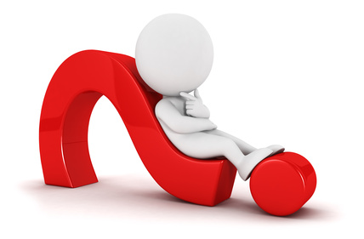
Thank you!

Slide 28
Thank You!
Iowa Vocational Rehabilitation Services
To find an office near you visit http://www.ivrs.iowa.gov/
or
contact our main office for a local number at
(800) 532-1486

