Slide 1
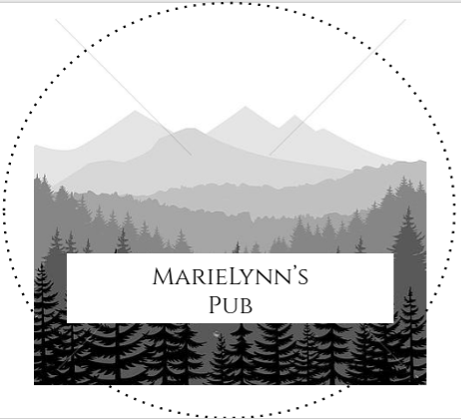
MarieLynn’s Pub
“Bring your bub to the pub”

Slide 2
Business Pitch
https://spark.adobe.com/video/o0CUxQdEpXotf

Slide 3
Business Summary
MarieLynn’s is Madison’s local woodsy themed pub offering good music, affordable tasty food and drinks and dancing to all ages in a safe, comfortable, and welcoming environment

Slide 4
Market Research
60.6% of Madison High School Students said that it was easy to obtain alcohol. By having a pub in Madison, we hope that parents will drink less at home, making alcohol less obtainable to teens
In Madison, there is only 1 sit-down restaurant and it is located 13 miles from the center of town. The rest of the restaurants in Madison focus on take-out food.
The closest pub is the Old Mill Pub in Skowhegan. However Marielynn’s has a million dollar view of Maine’s beautiful mountains.

Slide 5
Marketing Strategy
Our customers will be mostly adults, friends and family, and young adults. We will advertise to them by putting ads on the television and radio, also on most used apps (instagram, facebook, snapchat, etc…)
We will use others good reviews to promote MarieLynn’s on sites such as Yelp and TripAdvisor

Slide 6
Financial Plan
MarieLynn’s has a plan of bringing in roughly $1,000 per night with the average of $10 per meal and the approximately of 100 customers a night.
Our total cost to fund Marielynn’s the first year is $600,00 to $800,000.
MarieLynn’s will plan on selling trees off the land we buy and to get sponsors and pay back them with a percentage of our profit.
Bigelow Brewery would be a good partnership because they can be our exclusive alcohol distributor and we can support them with our business.

