Slide 1
Paintball, Airsoft, Laser Tag
Fun for the whole family

Slide 2
Business Pitch
Frozen Flame Video

Slide 3
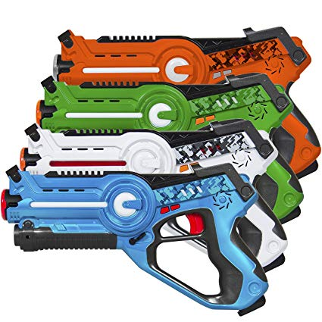
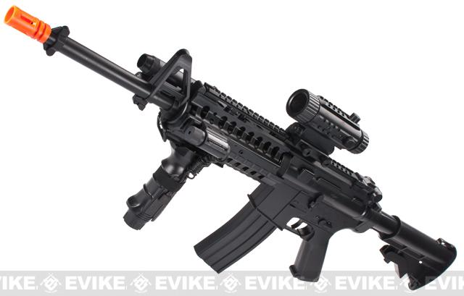
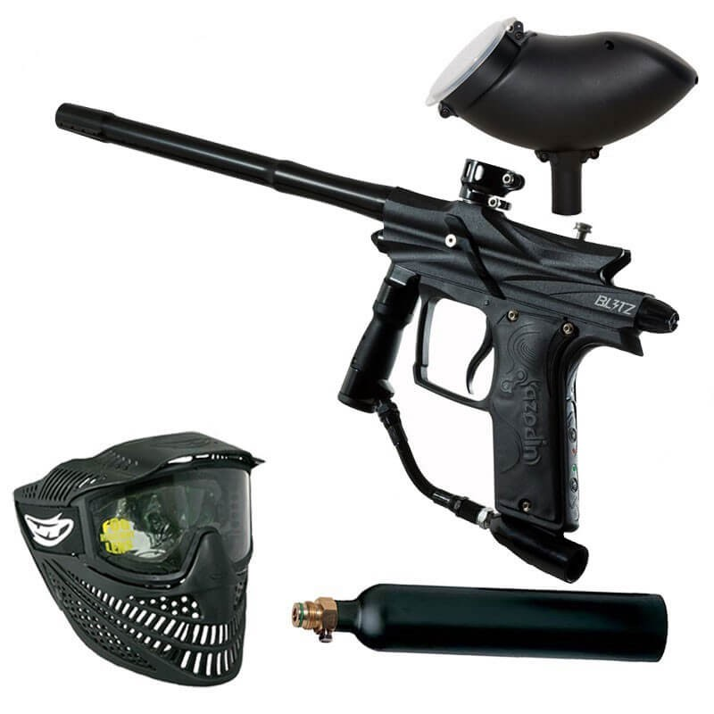
Equipment

Slide 4
Business Summary
Currently, the amount of physical activities available to youths in the town of Madison is sorely lacking.
The Frozen Flame will provide an outlet for the young adults of nearby towns and cities to go for an enjoyable time while working up a sweat.
Our business is a Laser-tag, Airsoft, and Paintball hybrid facility designed to provide physical activity targeting younger audiences in southern Maine.

Slide 5
Market Research
In a survey done in 2018 it showed of Madison High School students that out of 34 people about 79% would participate on an airsoft field. In the same survey out of 36 people about 89% said they would participate on an paintball field.
This company is needed because exactly 22.8% of high school in Madison are overweight according to the Maine Integrated Youth Health Survey. In addition, only 19.4% of students are physically active for 60 minutes or more daily, according to the same survey. This shows that more physical options would be good for the town of Madison.

Slide 6
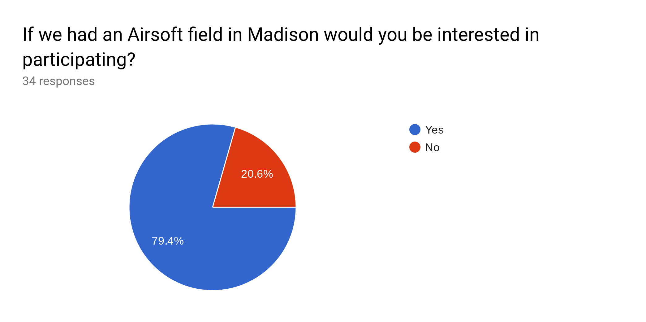
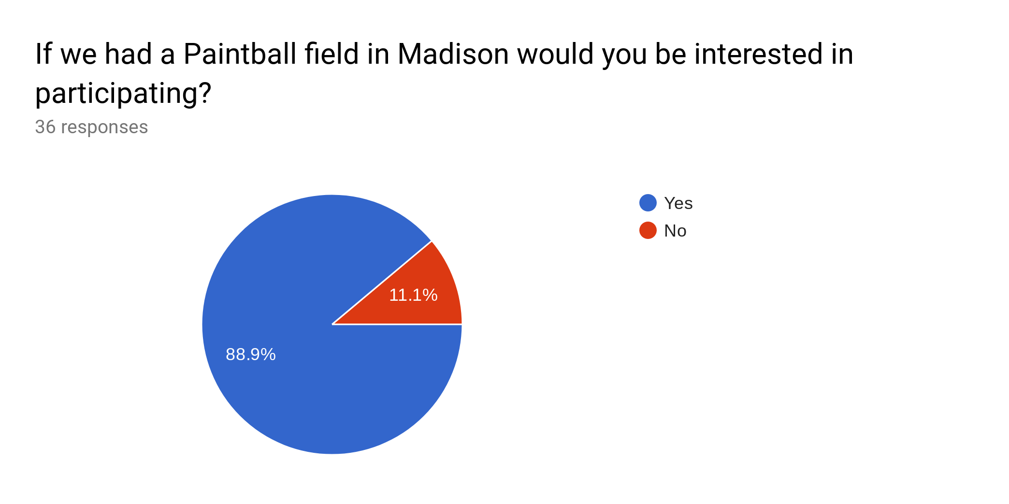
Market Research

Slide 7
Marketing Strategy
Our audience mainly consists of teens in local and surrounding communities. We would using a Facebook page and Instagram as well as newspaper ads, printed flyers, and TV commercials as a way of communicating our business.

Slide 8
Financial Plan
Revenue:
Monthly Membership= $40 per month
includes discounts on rentals, snacks, and drinks
Daily Fee= $10 a person
*does not include snacks and drinks
Party Rentals for Tournaments= $200
***We will also sell snacks, drinks, and merchandise

Slide 9
Financial Plan (Cont.)
Cost Structure:
Employees - $8,800 per month x 12= $105,600
Computers - $1,500
Electricity - $160 per month x 12= $1,920
Oil to heat the building in the winter - $1,215 per month x 12= $14,580
Security Cameras - $1,000
Airsoft, Paintball, Laser Tag Gear - $5,000
Internet - $36.70 per month x 12= $440.4
Insurance - $41.66 per month x 12= $499.92
Land - $100,000
Food Truck: Snack Bar - $250
NewsPaper Advert - $480
TV Advert - $3,113 per month x 12 = $37,356
Total Needed= $270,000

Slide 10
Financial Plan (Cont.)
We could obtain funds by applying for a business loan, attempt a corporate sponsorship, and start a GoFundMe page.
Potential partners we could obtain are Pepsi, Coca Cola, Redbull for beverage sponsors; Tokyo Marui, Classic Army, and CYMA for equipment sponsors; and Subway, Snack Shack, Pizzarama, and Al’s Pizza for local business partners.

Slide 11
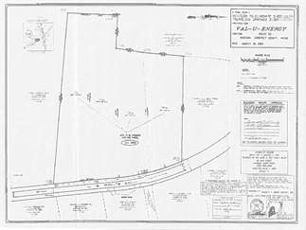
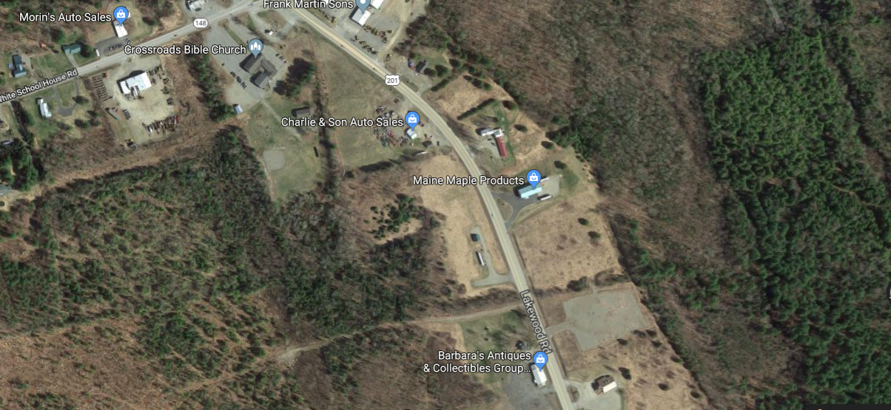
Location Route 201, Madison ME

